Slide 1
Secure coding and performance monitoring
Deepikkaa.S

Slide 2
JVM Architecture

Slide 3
What is a Virtual Machine?
It is a software simulation of a machine that can perform operations like a physical machine

Slide 4
Types of VM
Hard-ware-based or System based VM - It provides Several Logical systems on the same computer with strong Isolation from each other. The main advantage of Hard-ware based VM is for effective utilization of hardware resources: Examples
KVM (Kernal-Based VM) for Linux Systems
VMware (Virtual Machine ware)
Xen
Cloud Computing
Application-based or Software-based or Process-based VM: - These VM acts as Runtime Engines to Run a particular programming Language application. Examples:
JVM Acts as Runtime Engine to Run Java Applications
PVM (Parrot VM) acts as Runtime Engine to Run Scripting Language like PERL
CLR(Common Language Runtime) acts as Runtime Engine to run .Net Based applications

Slide 5
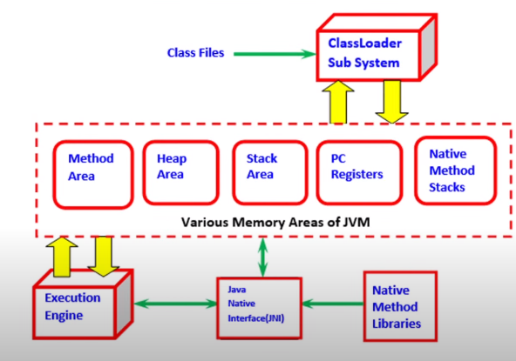
Basic Architecture Diagram of VM
JVM is a part of JRE
JVM is responsible to Load and Run Java Applications
JVM has 3 components:
Class Loader Subsystem:
To load class files to the memory area
2) Memory Area
3) Execution Engine :
To run the loaded class files

Slide 6
Types of Memory
Method Area: Class files will be loaded here
Heap Area: All Objects will be saved
Stack Area: To store local variables
PC Registers :(Program Counters) The current instruction under execution will be stored. For every thread, a separate PC register will be there.
Native Method Stacks: For every thread, a separate PC register will be there.

Slide 7
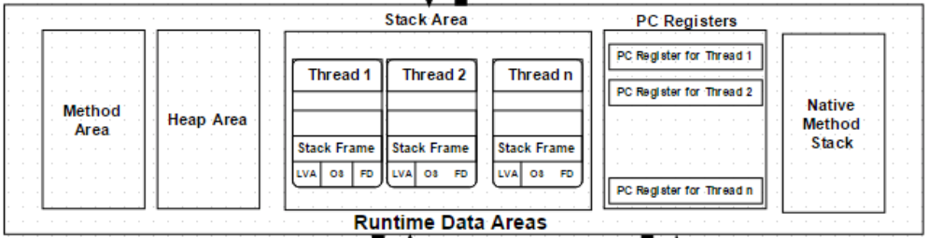
Memory area

Slide 8
Memory area
The method area and Heap area are shared. So objects available here are NOT thread-safe.
Data available in the stack are thread-safe safe as each thread has its own stack.

Slide 9
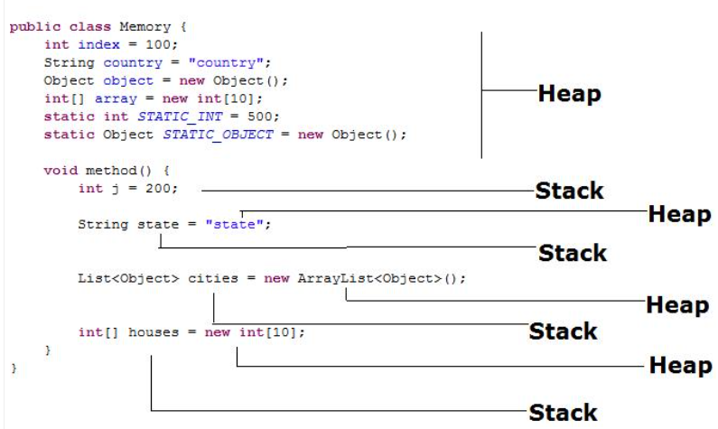
Stack and heap

Slide 10
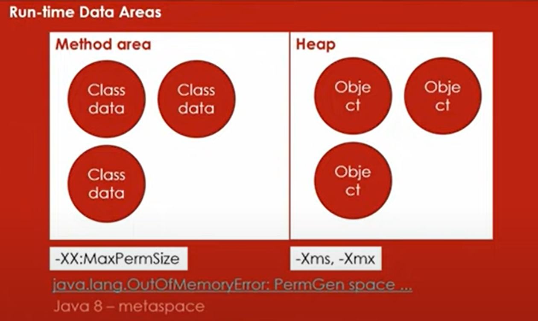
Memory area
Method area is called PermGen Space/metaspace -- by default 64MB is allocated -- throws java. lang.AutoMemoryError if this is full.
From Java 8, this method area is moved to a separate memory in the native OS. So there is NO limit from Java 8.
All the class-level data will be stored here, including static variables

Slide 11
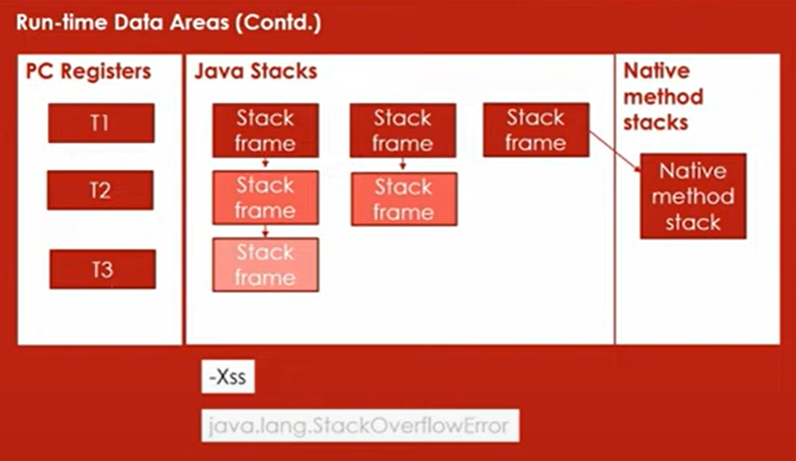
Memory area
While running the recursive function, many stack frames got created one above the other which leads to StackOverflowError.
Native Methods: Methods which is not implemented using Java. It is created using other languages like C. Eg: hashCode()
So to execute Native Methods, we need Native method libraries which are provided by JNI(Java Native Interface) to the execution engine.

Slide 12
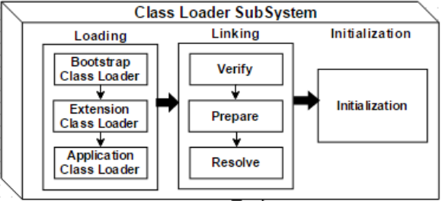
ClassLoadeR Sub system
It is responsible for 3 activities:
Loading
Linking
Verification
Preparation
Resolution
Initialization

Slide 13
ClassLoadeR Sub system - Loading
Classes will be loaded by this component.
BootStrap ClassLoader – Responsible for loading classes from the bootstrap classpath, nothing but rt.jar. The highest priority will be given to this loader.
Extension ClassLoader – Responsible for loading classes that are inside the ext folder (jre\lib).
Application ClassLoader –Responsible for loading Application Level Classpath, path mentioned Environment Variable, etc.

Slide 14
ClassLoadeR Sub system - Loading
The Class loader reads the “.class” file, generate the corresponding binary data and save it in the method area.
For each “.class” file, JVM stores the following information in the method area.
The fully qualified name of the loaded class and its immediate parent class.
Whether the “.class” file is related to Class or Interface or Enum.
Modifier, Variables and Method information etc.

Slide 15
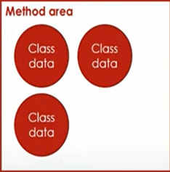
ClassLoadeR Sub system - Loading
After loading the “.class” file, JVM creates an object of type Class to represent this file in the heap memory.
Please note that this object is of type Class predefined in java.lang package.
These Class objects can be used by the programmer for getting class-level information like the name of the class, parent name, methods, and variable information, etc.
To get this object reference we can use the getClass() method of the Object class
Note: For every loaded “.class” file, only one object of the class is created.
Notes:
// A Java program to demonstrate working
// of a Class type object created by JVM
// to represent .class file in memory.
import java.lang.reflect.Field;
import java.lang.reflect.Method;
// Java code to demonstrate use
// of Class object created by JVM
public class Test {
public static void main(String[] args)
{
Student s1 = new Student();
// Getting hold of Class
// object created by JVM.
Class c1 = s1.getClass();
// Printing type of object using c1.
System.out.println(c1.getName());
// getting all methods in an array
Method m[] = c1.getDeclaredMethods();
for (Method method : m)
System.out.println(method.getName());
// getting all fields in an array
Field f[] = c1.getDeclaredFields();
for (Field field : f)
System.out.println(field.getName());
}
}
// A sample class whose information
// is fetched above using its Class object.
class Student {
private String name;
private int roll_No;
public String getName() { return name; }
public void setName(String name) { this.name = name; }
public int getRoll_no() { return roll_No; }
public void setRoll_no(int roll_no)
{
this.roll_No = roll_no;
}
}

Slide 16
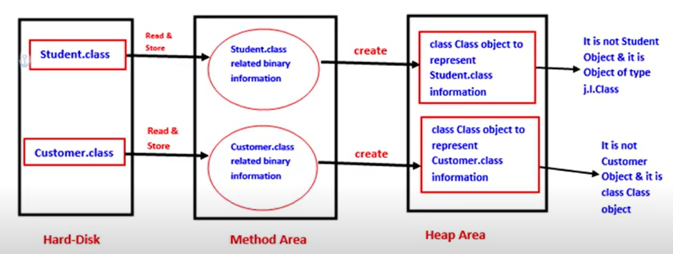
ClassLoadeR Sub system - Loading

Slide 17
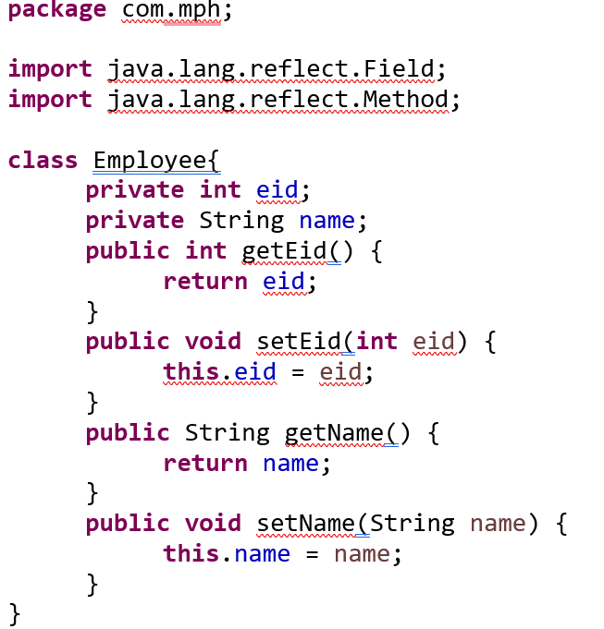
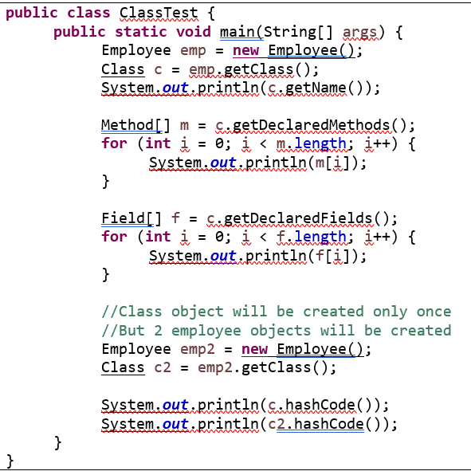
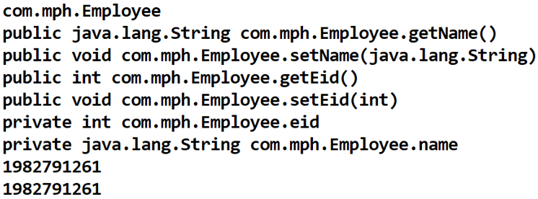
ClassLoadeR Sub system - Loading

Slide 18
ClassLoadeR Sub system - Linking
Linking consists of 3 Activities
Verification – byte code verifier verifies the right class file created by Javac
Preparation -- default values will be assigned for static variables
Resolution(optionally done)

Slide 19
ClassLoadeR Sub system - Linking
Verification:
It is the process of ensuring that the binary representation of a class is structurally current or not
That is JVM will check whether the .class file is generated by a valid compiler or not.
i.E whether the .class file is properly formatted or not.
→ Internally Byte code verifier which is part of the ClassLoader subsystem is responsible for this activity
If verification fails then we will get Runtime Exception saying java.lang.Verifiy Error.
Preparation:
In this phase JVM will allocate memory for the class-level static variables and assign default values(But not original values)
Note: Original values will be assigned in initialization phase.
Resolution:
It is the process of replacing symbolic references used by the loaded type with original references
Symbolic references are resolved into direct references by searching through the method area to locate the referenced entity.
Programmer-friendly references converted to machine-friendly references.

Slide 20
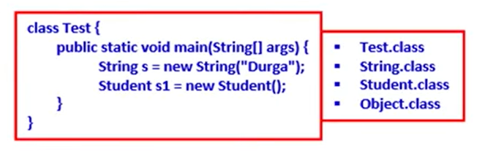
ClassLoadeR Sub system - Linking
For the below class, ClassLoader sub system loads Test.class, String.class, Student.class, and Object.class
The names of these class names are stored in constant pool of test class
In resolution phase, these names are replaced with actual reference from method area.

Slide 21
ClassLoadeR Sub system - Initialization
In this phase all static variables will be assigned with original values and static blocks will be executed from top to bottom and from Parent to Child
Note: While loading, linking, and initialization if any error occurs then we will get Runtime Exception saying java.lang.LinkageError.
OfCourse VerifyError is a child class of LinkageError only.

Slide 22
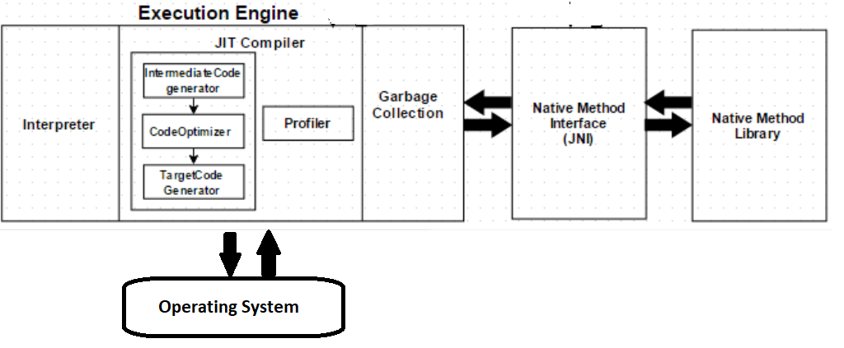
Execution Engine

Slide 23
Execution Engine
The bytecode, which is assigned to the Runtime Data Area, will be executed by the Execution Engine. The Execution Engine reads the bytecode and executes it piece by piece.
Interpreter – The interpreter interprets the bytecode faster but executes slowly. The disadvantage of the interpreter is that when one method is called multiple times, every time a new interpretation is required.
JIT Compiler – The JIT Compiler neutralizes the disadvantage of the interpreter. The Execution Engine will be using the help of the interpreter in converting byte code, but when it finds repeated code it uses the JIT compiler, which compiles the entire bytecode and changes it to native code. This native code will be used directly for repeated method calls, which improve the performance of the system.
Intermediate Code Generator – Produces intermediate code
Code Optimizer – Responsible for optimizing the intermediate code generated above
Target Code Generator – Responsible for Generating Machine Code or Native Code
Profiler – A special component, responsible for finding hotspots, i.e. whether the method is called multiple times or not.
Both the Java interpreter and JIT compiler work simultaneously to translate the byte code instruction into machine code instruction.

Slide 24
Execution Engine
Garbage Collector: Collects and removes unreferenced objects. Garbage Collection can be triggered by calling System.gc(), but the execution is not guaranteed. Garbage collection of the JVM collects the objects that are created.
Java Native Interface (JNI): JNI will be interacting with the Native Method Libraries and provides the Native Libraries required for the Execution Engine.
Native Method Libraries: This is a collection of the Native Libraries, which is required for the Execution Engine.

Slide 25
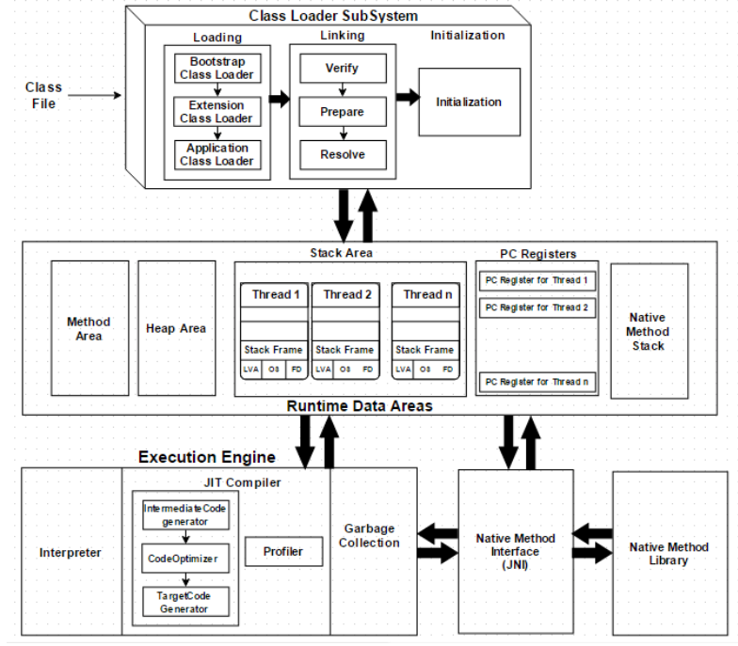
The complete architecture of JVM

Slide 26
Garbage collection
Java provides automatic memory management through a program called Garbage Collector. Garbage collection is a process by which a run-time environment automatically de-allocates and reclaims unused memory.
It removes objects that are not used anymore.
Live object = reachable(referenced by someone else)
Dead object = unreachable(not referenced from anywhere)
Based on the following hypothesis:
Most objects soon become unreachable
References from ‘old’ objects to ‘young’ objects only exist in small numbers.

Slide 27
Garbage collection
Garbage collection algorithms fall into two broad categories:
reference counting
tracing collection
Reference Counting
Tracing Collectors
Mark and Sweep
Stop-and-Copy
Generational Collectors
Notes:
http://web.eecs.utk.edu/~bvanderz/cs365/notes/garbage-collection.html

Slide 28
Reference Counting
Reference Counting
Keeps track of the number of pointers that reference each block of memory in the heap and adds a block of memory to the free list when its reference count drops to 0 each memory block contains a four-byte field that counts the number of references to this block
the compiler inserts statements that increment or decrement reference counts around program statements that perform pointer variable assignment
Advantages
the cost of garbage collection is distributed uniformly over a program's execution so there is never an irritating pause in program execution
Disadvantage
reference counting statement must be added before and after every program statement that performs a pointer assignment. These statements can increase the cost of a pointer assignment by a factor of 3.
reference counting cannot garbage collect circular structures
every block of memory must have an extra four bytes that are devoted to reference counting.

Slide 29
Tracing Collectors - Mark and Sweep
Tracing collectors work by marking objects as either usable or un-usable and reclaiming un-usable objects
Mark and Sweep:
Walk through the heap and mark every block as "useless“
For each pointer outside the heap do a depth-first search and mark all blocks that are encountered as "useful." (when the collector reaches a block already marked as "useful" it knows it has reached the block via some other path and can stop recursing) Doing a depth-first search means having to recurse into structures.
Walk through the heap again and move every block still marked as "useless" to the free list
Advantages
requires less overhead than reference counting since it is only called when free memory is exhausted
garbage collects circular structures
Disadvantages
Can cause long annoying pauses when garbage collection occurs.
Requires a strongly typed language and each memory block must start with a pointer to a type descriptor.

Slide 30
Tracing Collectors - Stop-and-Copy
Stop-and-Copy
A technique that can eliminate memory fragmentation by compacting storage
Heap is divided into two spaces, only one of which is active Copies reachable objects from active to inactive space
Switches active and inactive spaces when copying is done.
When one half fills up, it copies the usable memory to the other half, compacts the storage, and patches up pointers.
When a half is nearly full, the collector starts its exploration of reachable data structures. Each reachable block is copied into the second half of the heap, with no external fragmentation
The old version of the block, in the first half of the heap, is overwritten with a "useful" flag and a pointer to the new location.
Any pointer that refers to the same block and that is found later in the exploration is updated to point to the new location.
Advantages
Eliminates memory fragmentation
Eliminates steps 1 and 3 of mark-and-sweep
Disadvantage:
Halves the heap size, although as noted earlier, it only really halves the virtual memory heap size

Slide 31
Tracing Collectors - Generational Collectors
Most dynamically allocated objects are short-lived, so they can be placed in a "nursery" region and garbage collected more quickly
Memory is divided into multiple regions, often just two, with one region being the nursery region and one being the long-lived region
When space runs low, the garbage collector garbage collects in the nursery region. If not enough space can be reclaimed in the nursery region, garbage collects successively in higher regions, thus weeding out older lived blocks that have become unusable.
After some number of collections, frequently just one, blocks get promoted from their region to the next older region in a manner similar to stop-and-copy.
Advantage:
Decreases the length of pauses by garbage collecting smaller regions
Disadvantage:
Much more complicated and can slow down overall execution by requiring the instrumentation of pointer assignments.
However, the instrumentation is pretty cheap.
Notes:
Types of Trace-Based Garbage Collectors
Mark-and-Sweep: Marks each reachable node in first phase Releases every unmarked node in the second phase.
Copying Collector: Heap is divided into two spaces, only one of which is active Copies reachable objects from active to inactive space Switches active and inactive spaces when copying is done Generational GC: Objects are divided into old and new generations, and new generations are collected more often
Concurrent GC: Garbage collector runs concurrently (e.g. in a separate thread) with the program; the program is not interrupted for collection

Slide 32
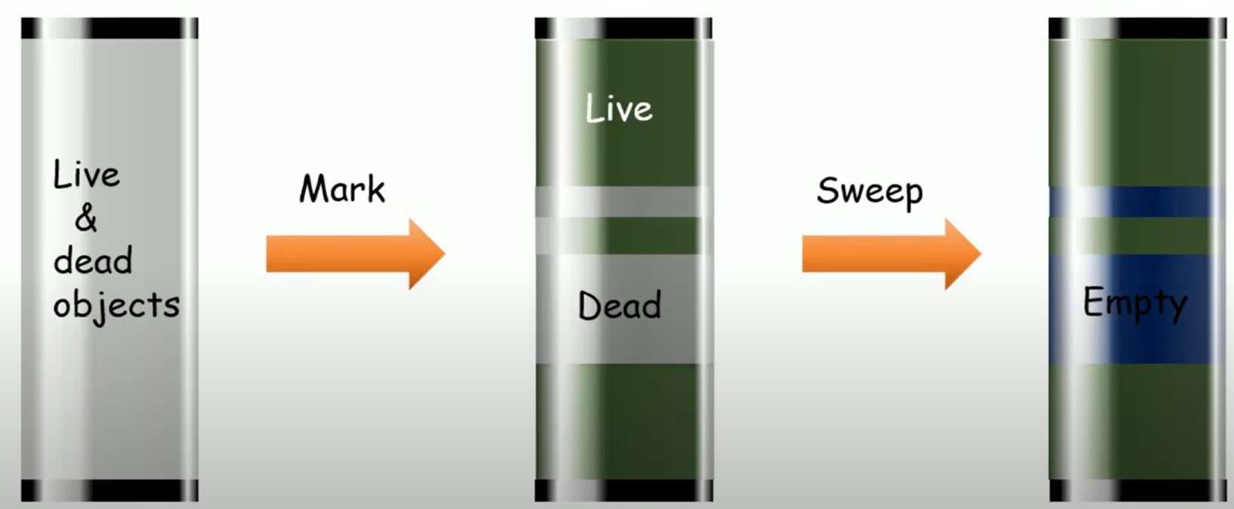
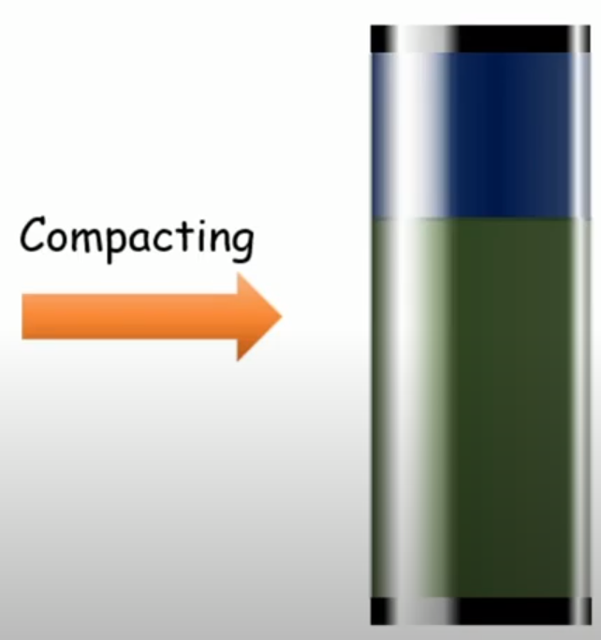
Phases of garbage collection – mark –sweep-compact

Slide 33
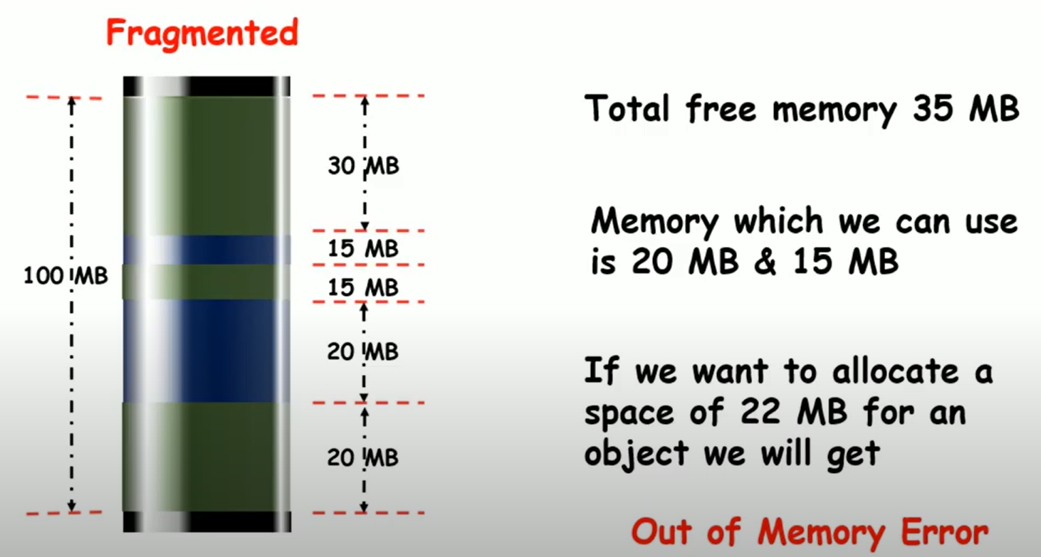
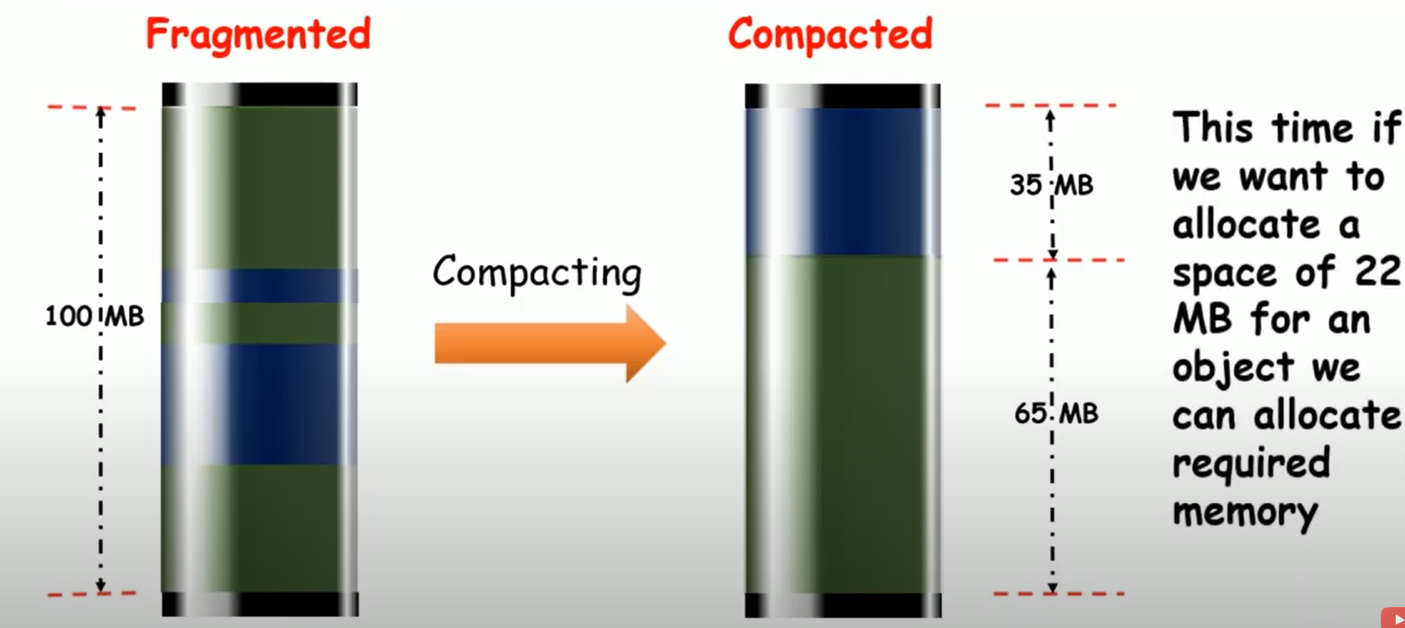
Why compacting?

Slide 34
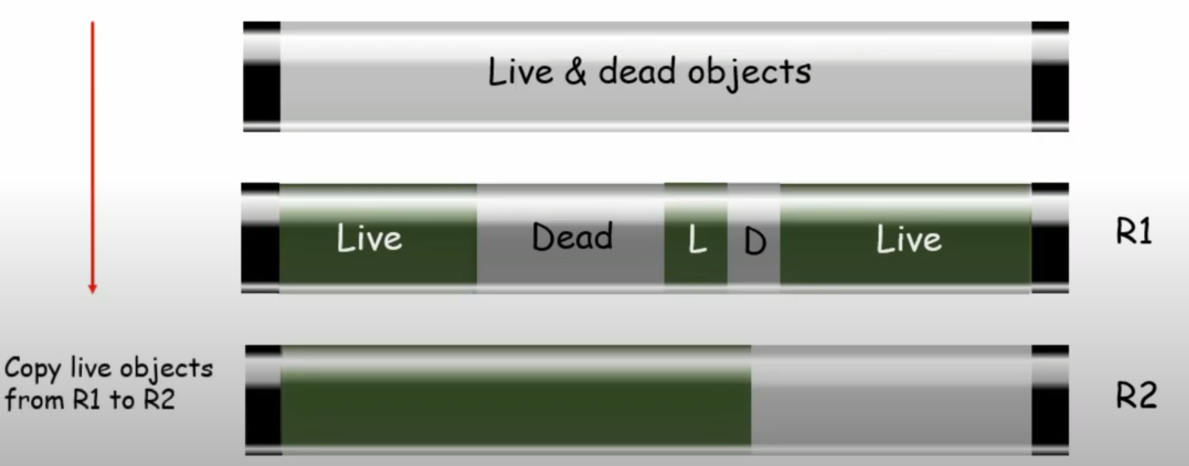
Mark and copy

Slide 35
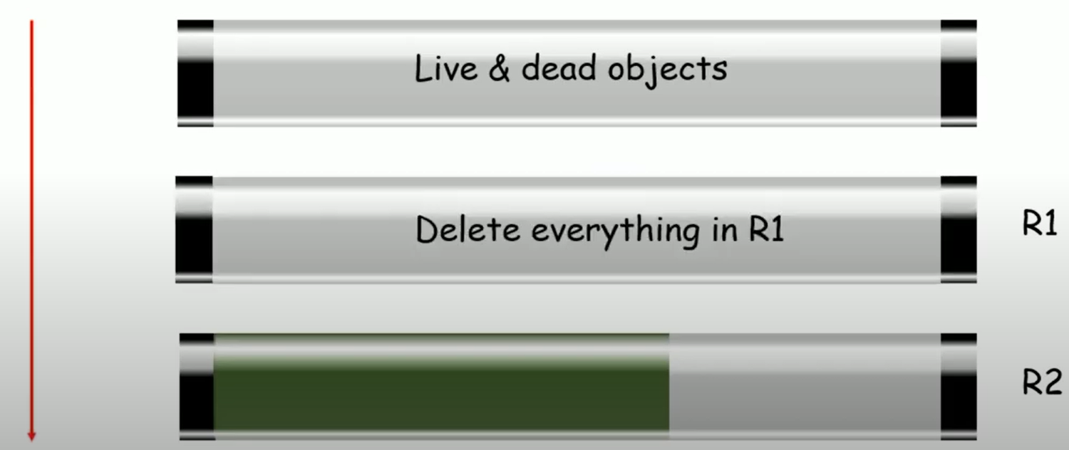
Mark and copy

Slide 36
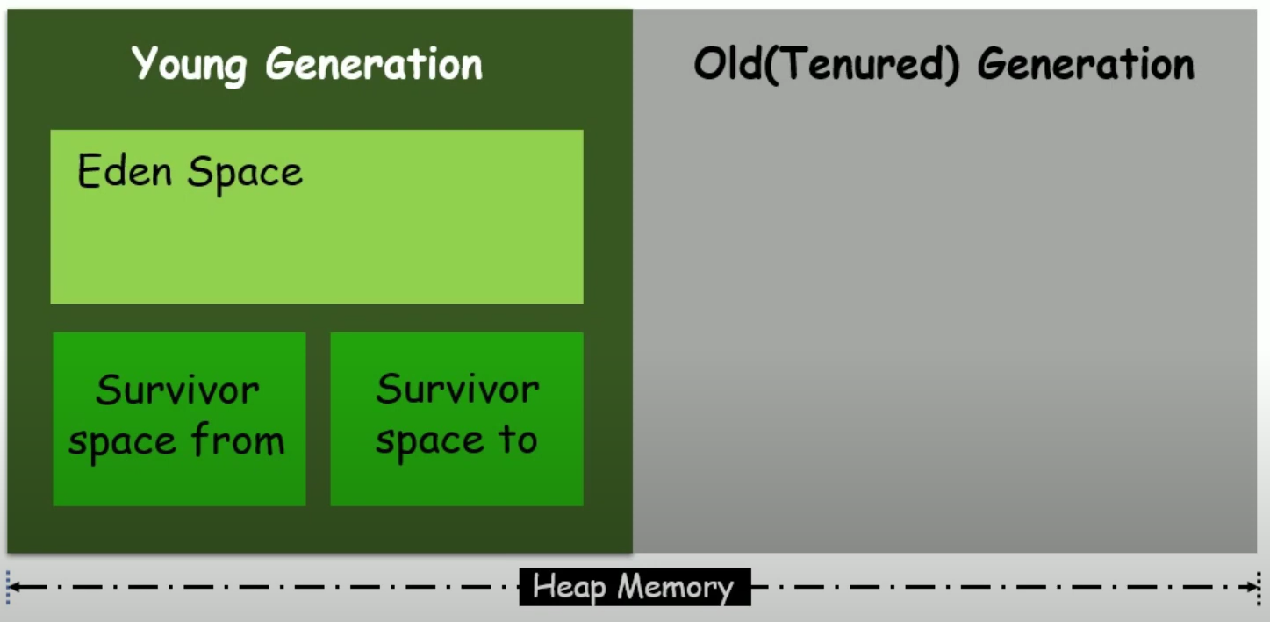
Generational collectors

Slide 37
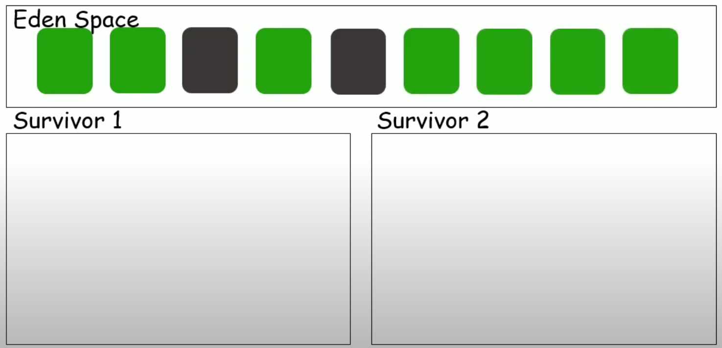
Generational collectors
New objects are created in Eden space.
When the Eden gets full, it will perform Minor GC and it moves all Live Objects from Eden to S1 and dead objects will be garbage collected.

Slide 38
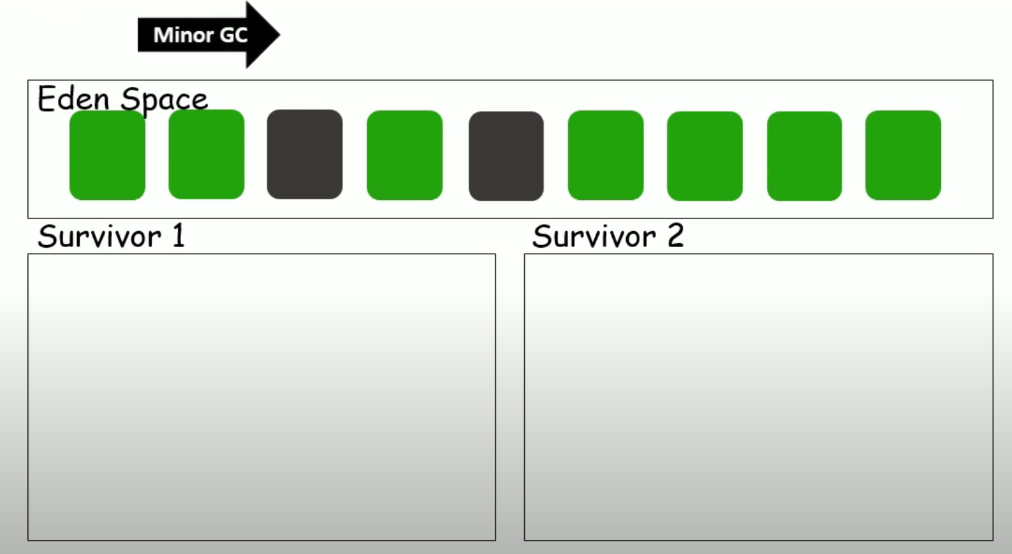
Generational collectors
When the Eden gets full, it will perform Minor GC

Slide 39
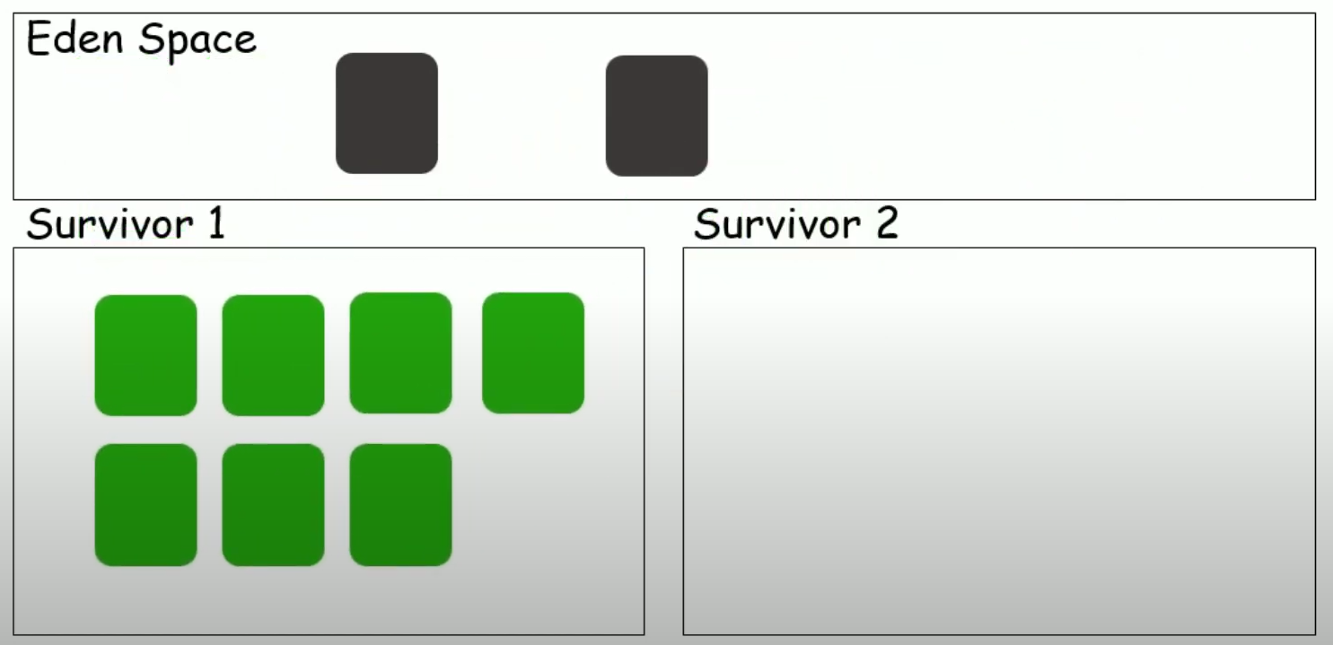
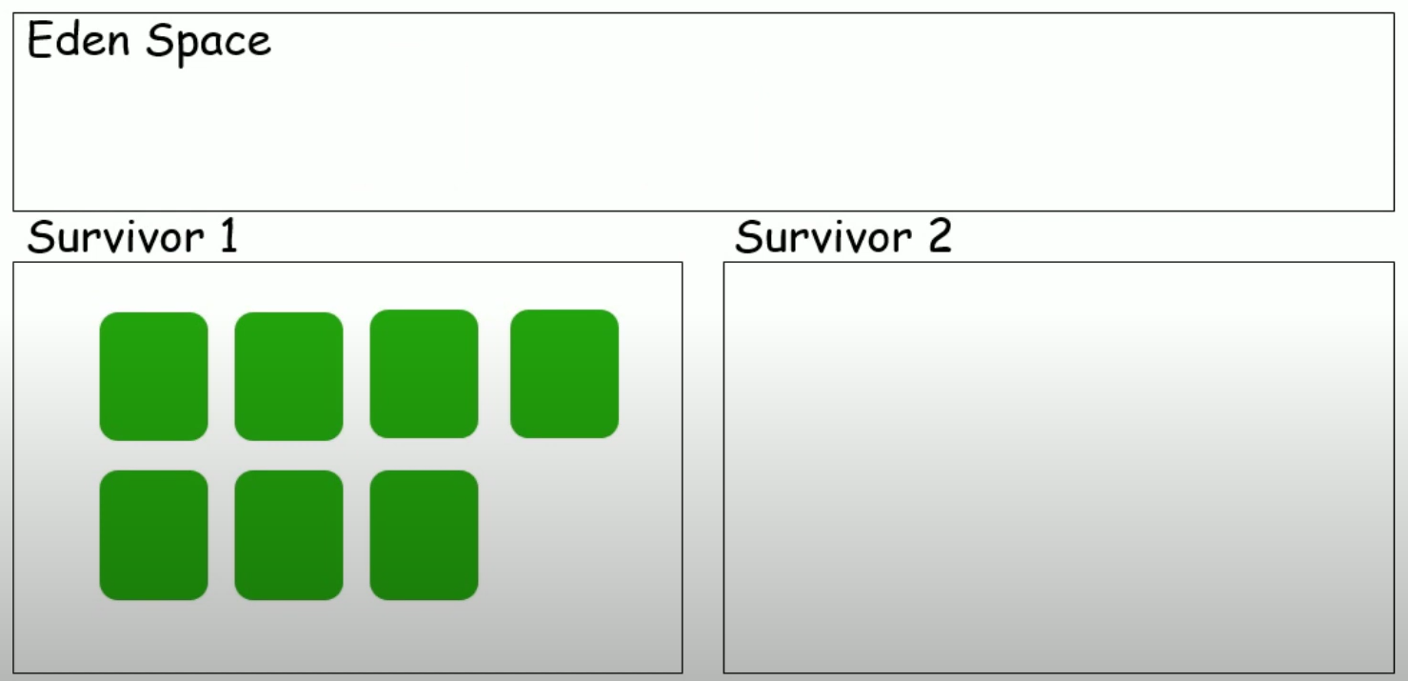
Generational collectors
It moves all Live Objects from Eden to S1 and dead objects will be garbage collected.

Slide 40
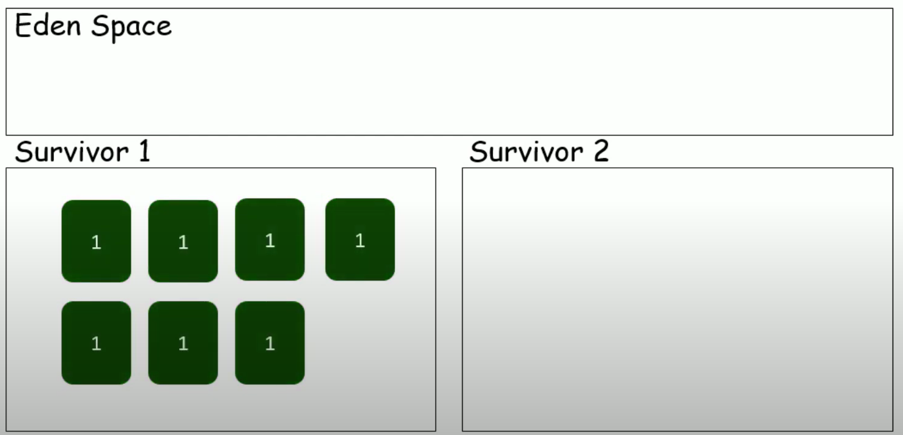
Generational collectors
The objects which are moved are marked as 1. It means that these objects survived one cycle of GC.
Now Eden is ready to accept new objects.

Slide 41
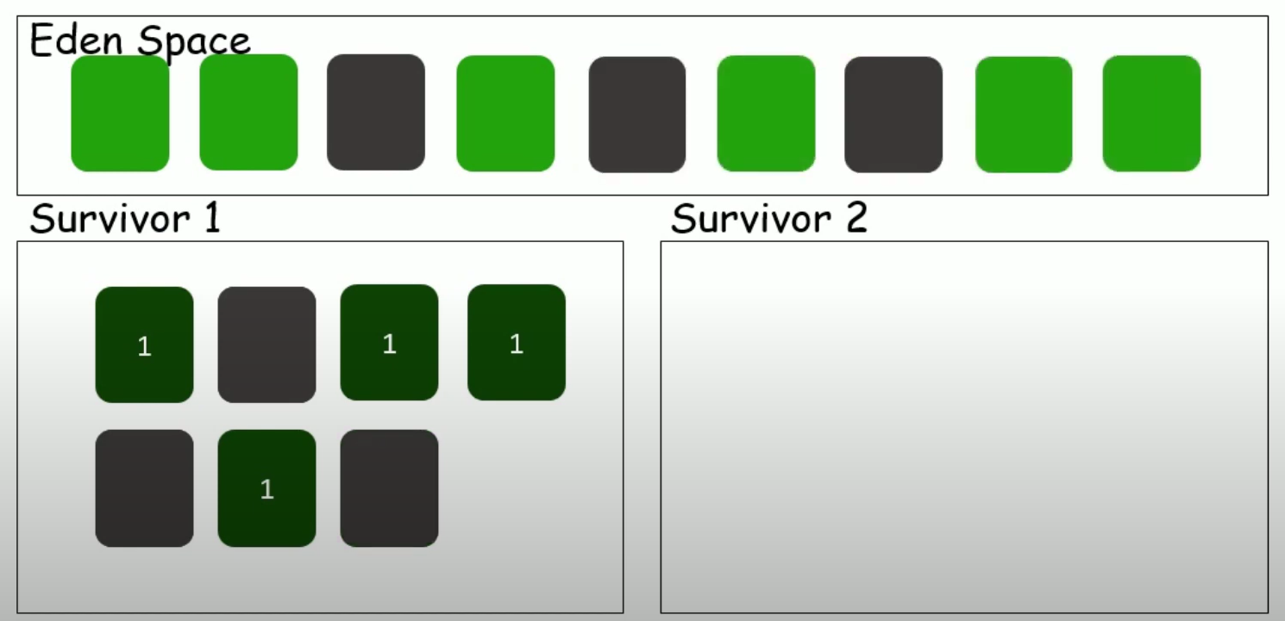
Generational collectors
Again Eden will have Live objects and Dead objects. At the same time, S1 will also have dead objects.

Slide 42
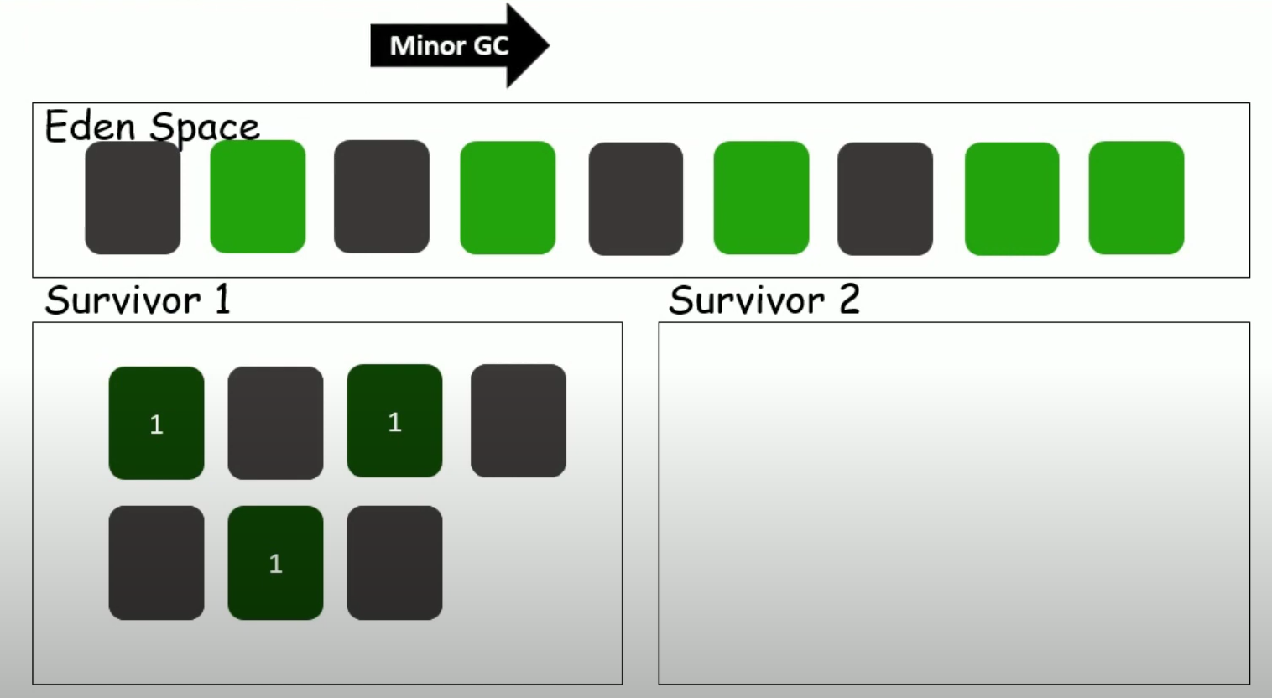
Generational collectors
Once Eden is full, Minor GC is initiated

Slide 43
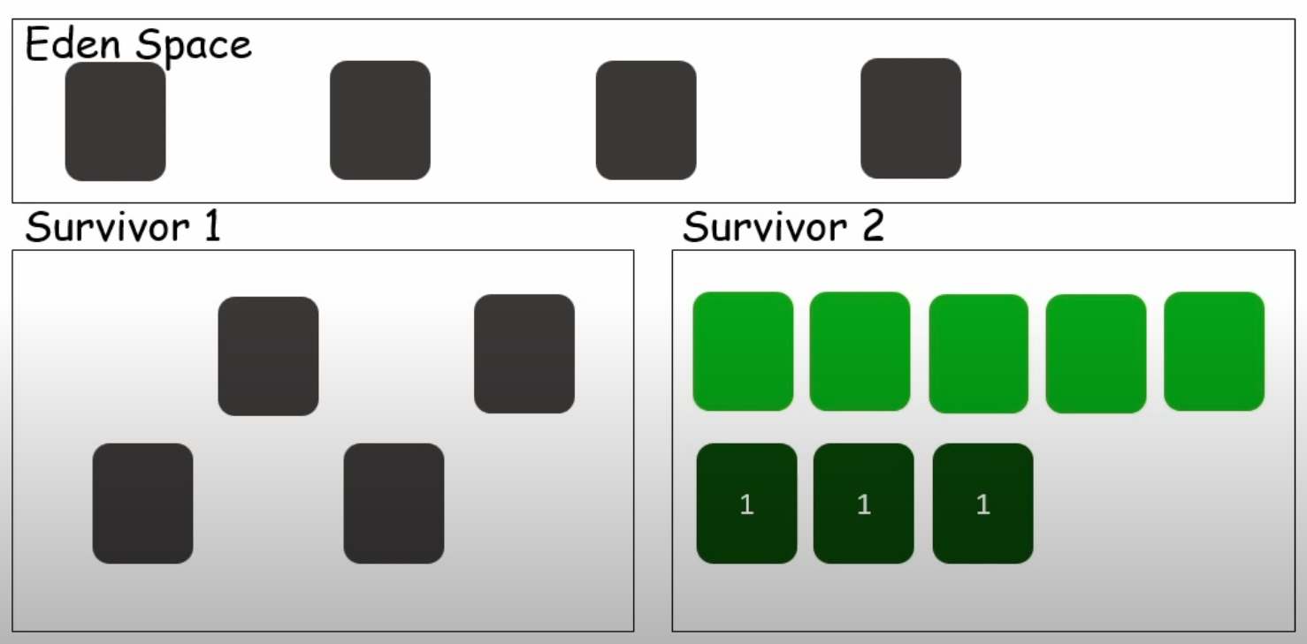
Generational collectors
Now Minor GC will collect all the Live objects from Eden space and S1 to S2.

Slide 44
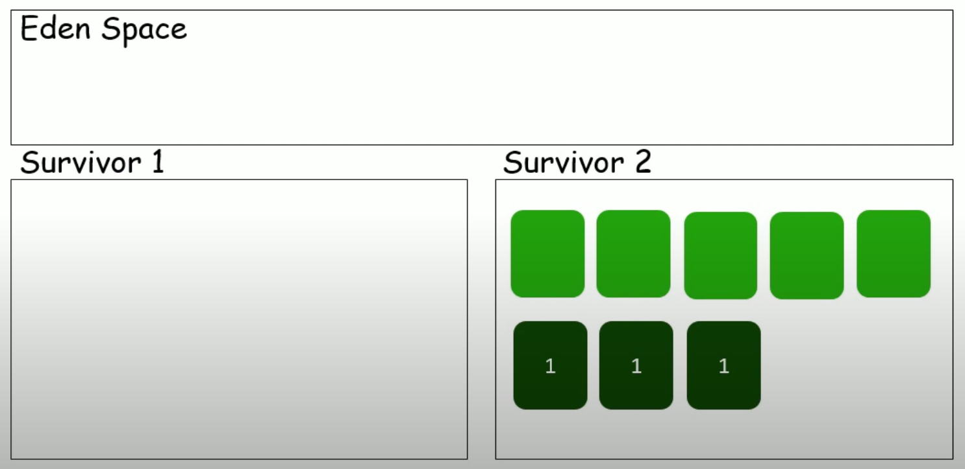
Generational collectors
Dead Objects are Garbage collected. Now the counters for the Live Objects will be incremented by 1.

Slide 45

Generational collectors
This denotes few objects survived one cycle of GC and few survived for two cycles of GC.
Now the Eden space is ready to accept new set of objects.

Slide 46
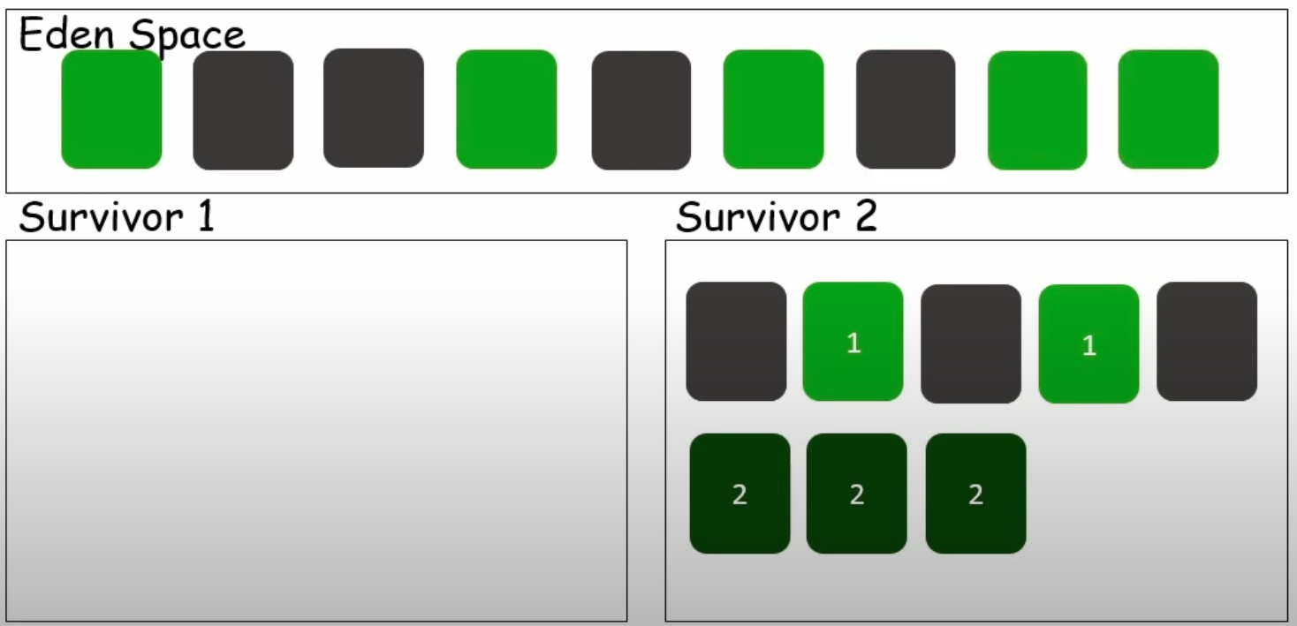
Generational collectors

Slide 47
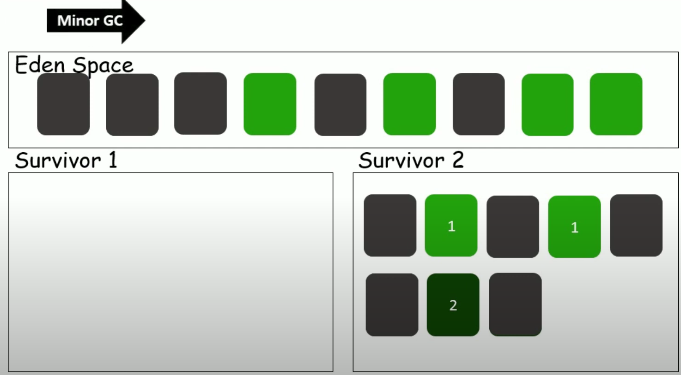
Generational collectors
Once the Eden is full, Minor GC is performed.
Now again we have Live and Dead Objects in both the spaces.

Slide 48
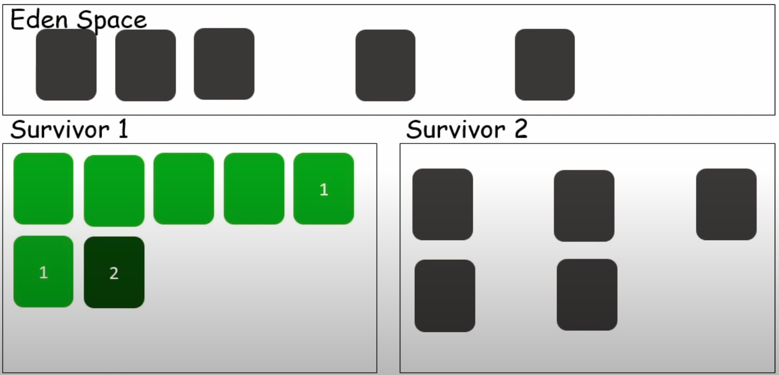
Generational collectors
After Minor GC, the Live objects from Eden space and S2 are copied to S1.
The Dead Objects are deleted from Eden and S2 space.

Slide 49
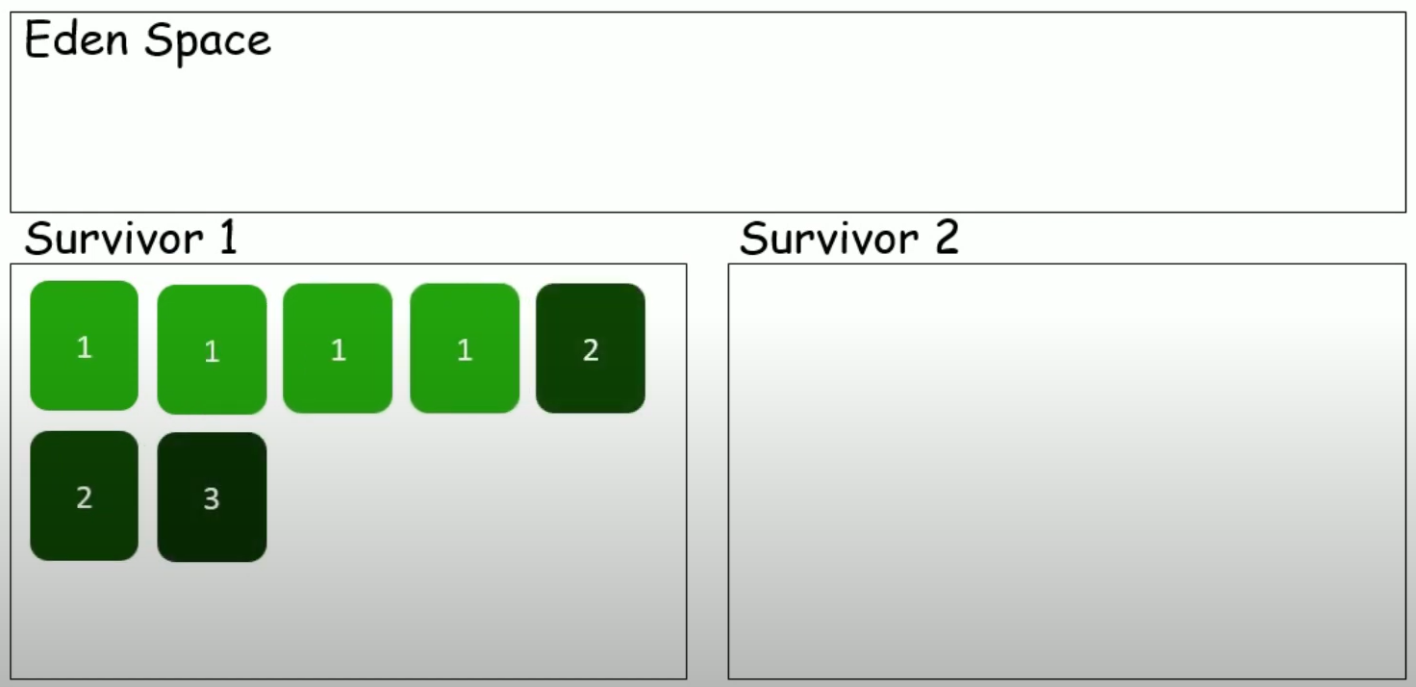
Generational collectors
After deleting the dead objects, the counters are incremented in the Live Objects.

Slide 50
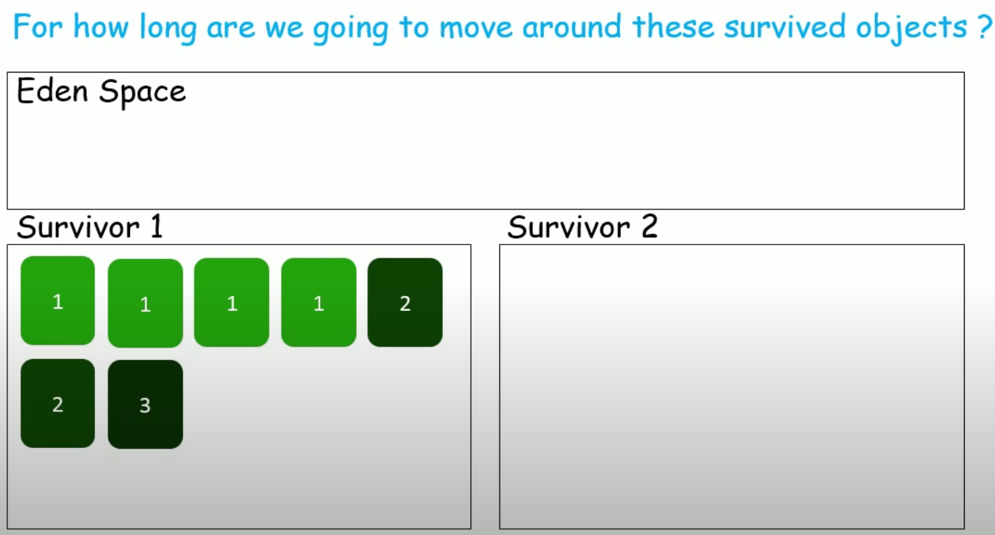
Generational collectors

Slide 51
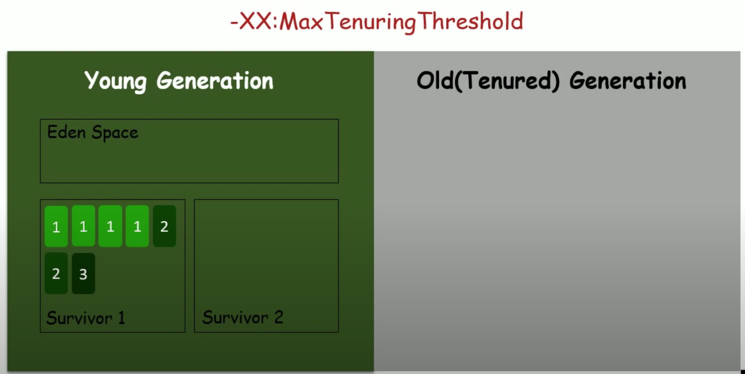
Generational collectors
How long the swapping happens like this is based on the value assigned to the MaxTenuringThreshold flag.

Slide 52
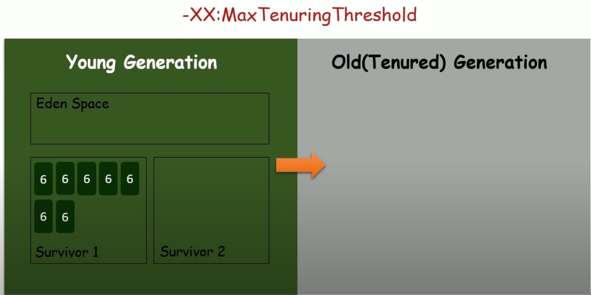
Generational collectors
If the value of the threshold is 6, those are promoted to Old Generation from Young Generation

Slide 53
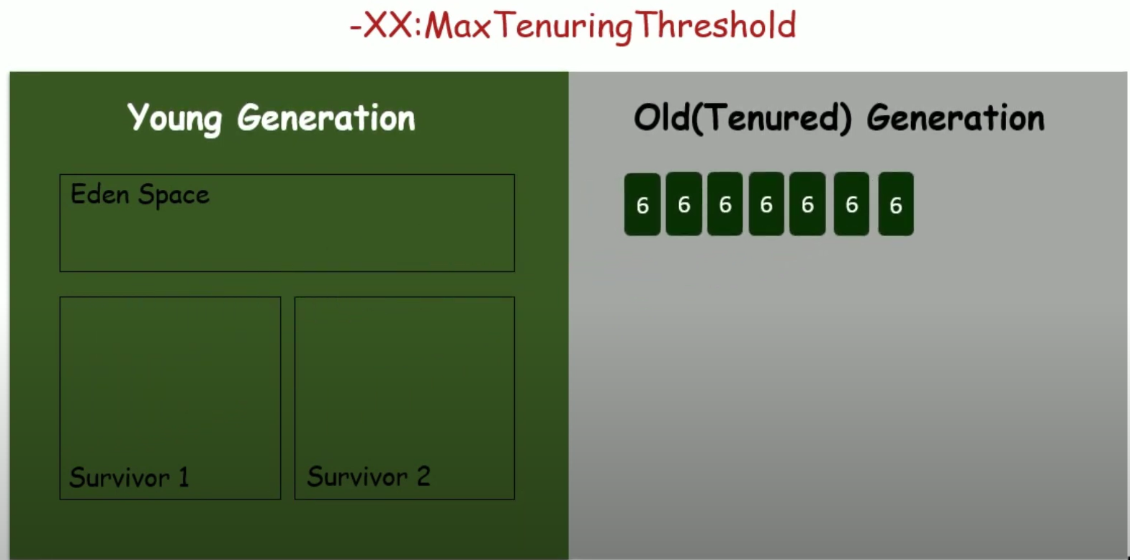
Generational collectors
Why do we need to do all these very often?
TO AVOID FULL GC.

Slide 54
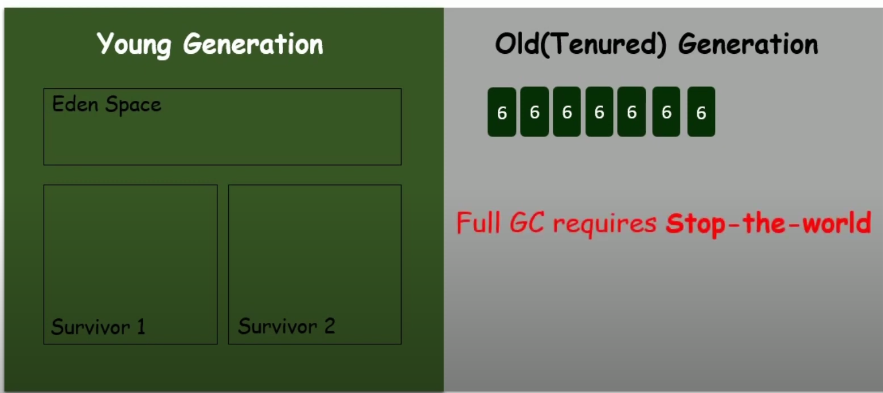
Generational collectors
When the Old Generation gets FULL, it initiates full GC.
Stop-the-world pause the running Application till it completes the GC.
Minor GC will not stop the Application.

Slide 55
Performance
GC pause time is so important criterion w.r.t performance. What to choose: Responsiveness/latency or throughput.
Responsiveness/latency: How quickly the application responds with a requested piece of data.
Example: How quickly the desktop UI responds to an event
How fast a website returns a data
How fast the database query is returned
If the application is focused on responsiveness, LARGE PAUSE TIMES ARE NOT ACCEPTABLE. The focus is on responding in short period of time

Slide 56
Performance
Throughput
Throughput focuses on maximizing the amount of work by an application in a specific period of time.
Example:
The no.of transactions completed in a given time.
The number of jobs that the batch program can complete in an hour
The number of database queries completed in an hour.
HIGH PAUSE TIMES ARE ACCEPTABLE FOR APPLICATIONS THAT FOCUS ON THROUGHPUT. Since high throughput applications focus on benchmarks over longer periods of time, quick response time is not a consideration.

Slide 57
Types of garbage collectors
A Serial GC
A basic GC that runs in a single thread, Can be used for basic applications
A Concurrent GC
A thread that performs GC along with application execution as the application runs, does not wait for the old generation to be full. Stop the world only during mark/remark.
A Parallel GC
Uses multiple CPUs to perform GC. Multiple threads doing Mark/Sweep etc. Does not kick in until the heap is full/ near full. Stops-the-world when it runs.

Slide 58
Garbage collectors
Use concurrent collectors(CMS) when
There is more memory
There is a high number of CPUs
Application demands short pauses
Most of financial application uses this CMS
Use parallel collector when
There is less memory
There is a lesser number of CPUs
Applications demand high throughput and can withstand pauses

Slide 59
Garbage collectors
G1 garbage collector(Garbage First)
Latest entry into GC (officially available in 1.7 update 4 onwards)
It straddles the young-tenured generation boundary as it divides the heap into different regions and during a GC it can collect a sub-set of regions. It dynamically selects a set of regions to act as the young generation in the next GC cycle. Regions with the most garbage(unreachable) will be collected first
Why G1GC?
More predictable(tunable) GC pauses
Low pauses with fragmentation
Uses Parallelism and concurrency together
Results in Better heap utilization

Slide 60
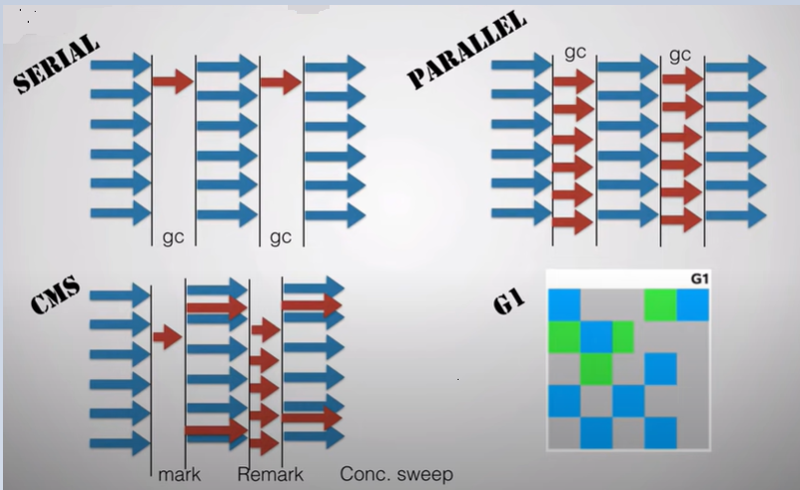
Garbage collectors

Slide 61
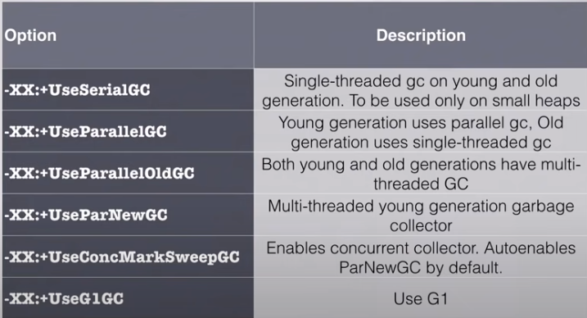
How to use Garbage colelctors

Slide 62
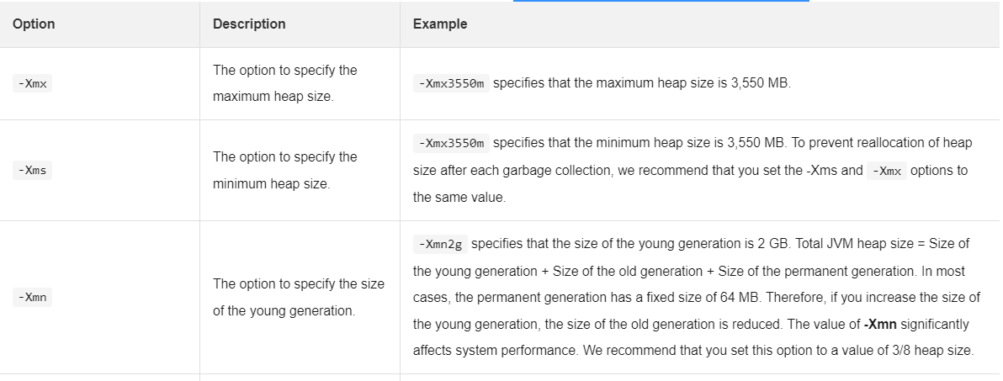
Tune the heap – JVM options to control heap size
https://www.alibabacloud.com/help/en/sae/latest/best-practices-for-jvm-heap-size-configuration
Notes:
https://www.alibabacloud.com/help/en/sae/latest/jvm-options

Slide 63
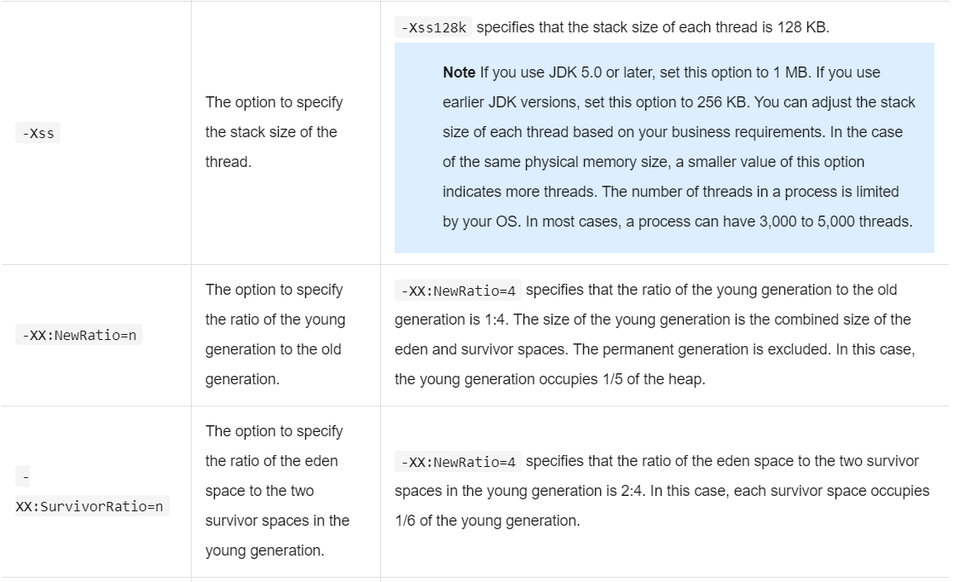
Tune the heap – JVM options to control heap size
Notes:
https://www.alibabacloud.com/help/en/sae/latest/jvm-options

Slide 64
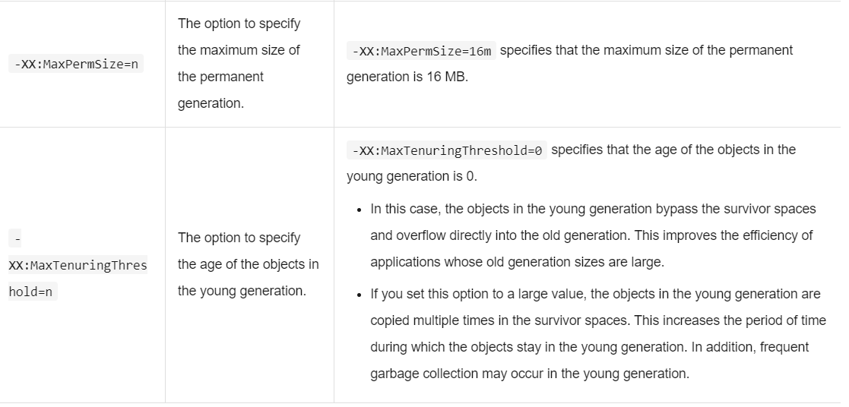
Tune the heap – JVM options to control heap size
Notes:
https://www.alibabacloud.com/help/en/sae/latest/jvm-options

Slide 65
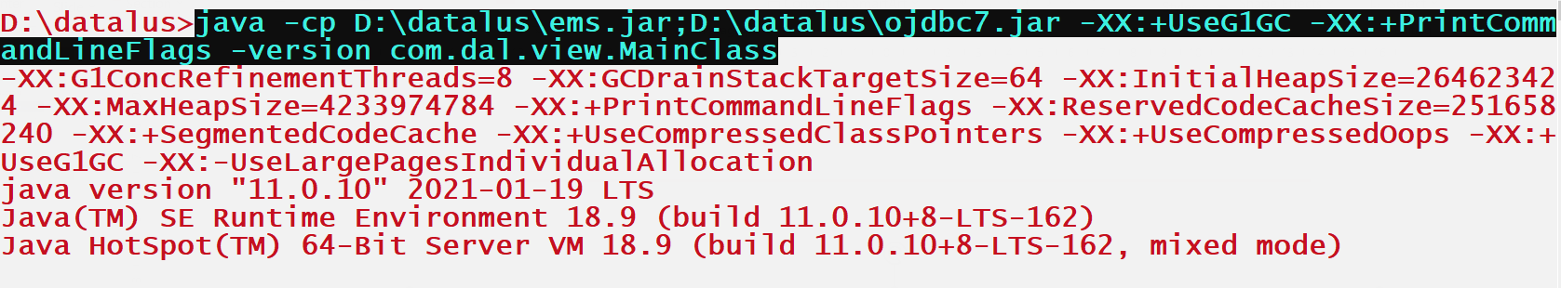
java: The command to invoke the Java Virtual Machine.
-cp D:\datalus\ems.jar;D:\datalus\ojdbc7.jar: This sets the classpath for the JVM, which tells it where to find the
required classes and libraries for the program being executed. In this case, it specifies two JAR files, ems.jar and ojdbc7.jar, located in the directories D:\datalus\.
-XX:+UseG1GC: This enables the use of the Garbage-First (G1) garbage collector, which is a server-style garbage collector introduced in Java 7
that is designed to have low pause times and high throughput.
-XX:+PrintCommandLineFlags: This option causes the JVM to print the flags and their values on the command line that were used to launch the JVM.
-version: This option prints the version of the JVM being used.
com.dal.view.MainClass: This is the fully-qualified name of the class to be executed. In this case, it is MainClass in the package com.dal.view.

Slide 66
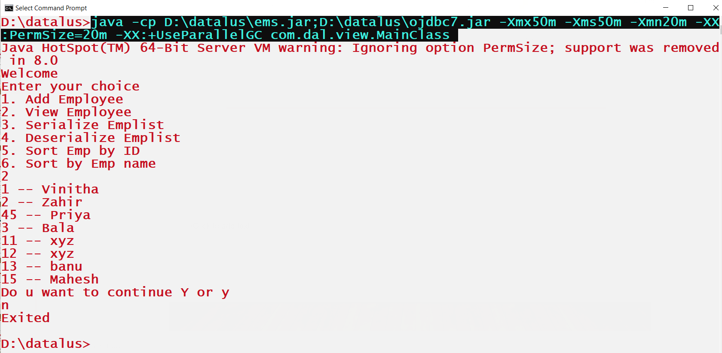

Slide 67
java -cp D:\datalus\ems.jar;D:\datalus\ojdbc7.jar -Xmx50m -Xms50m -Xmn20m -XX:PermSize=20m -XX:+UseParallelGC com.dal.view.MainClass
java: The command to invoke the Java Virtual Machine.
-cp D:\datalus\ems.jar;D:\datalus\ojdbc7.jar: This sets the classpath for the JVM, which tells it where to find the required classes and libraries for the program being executed. In this case, it specifies two JAR files, ems.jar and ojdbc7.jar, located in the directories D:\datalus\.
-Xmx50m -Xms50m -Xmn20m -XX:PermSize=20m -XX:+UseParallelGC: These are JVM options that configure the behavior of the JVM at runtime.
-Xmx50m: This sets the maximum heap size to 50 MB.
-Xms50m: This sets the initial heap size to 50 MB.-Xmn20m: This sets the size of the young generation to 20 MB.
-XX:PermSize=20m: This sets the size of the permanent generation (for storing metadata about classes) to 20 MB.
-XX:+UseParallelGC: This enables the use of the parallel garbage collector, which uses multiple threads to perform garbage collection.
com.dal.view.MainClass: This is the fully-qualified name of the class to be executed. In this case, it is MainClass in the package com.dal.view.

Slide 68
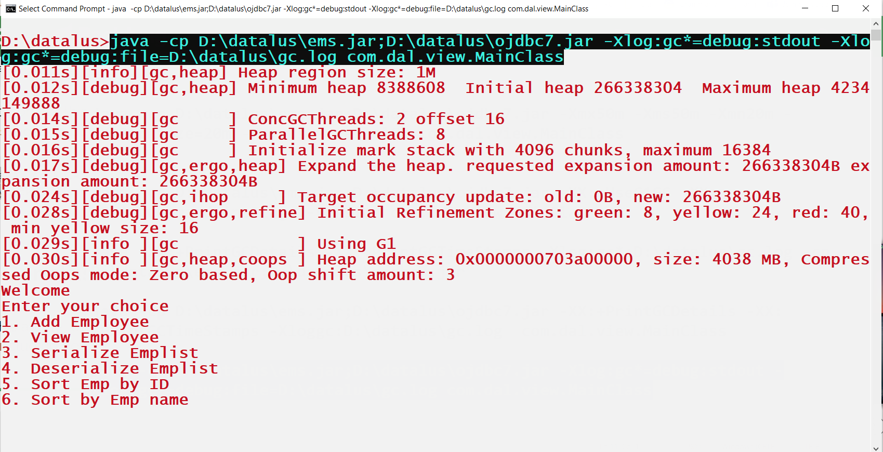
Java version 9 and above

Slide 69
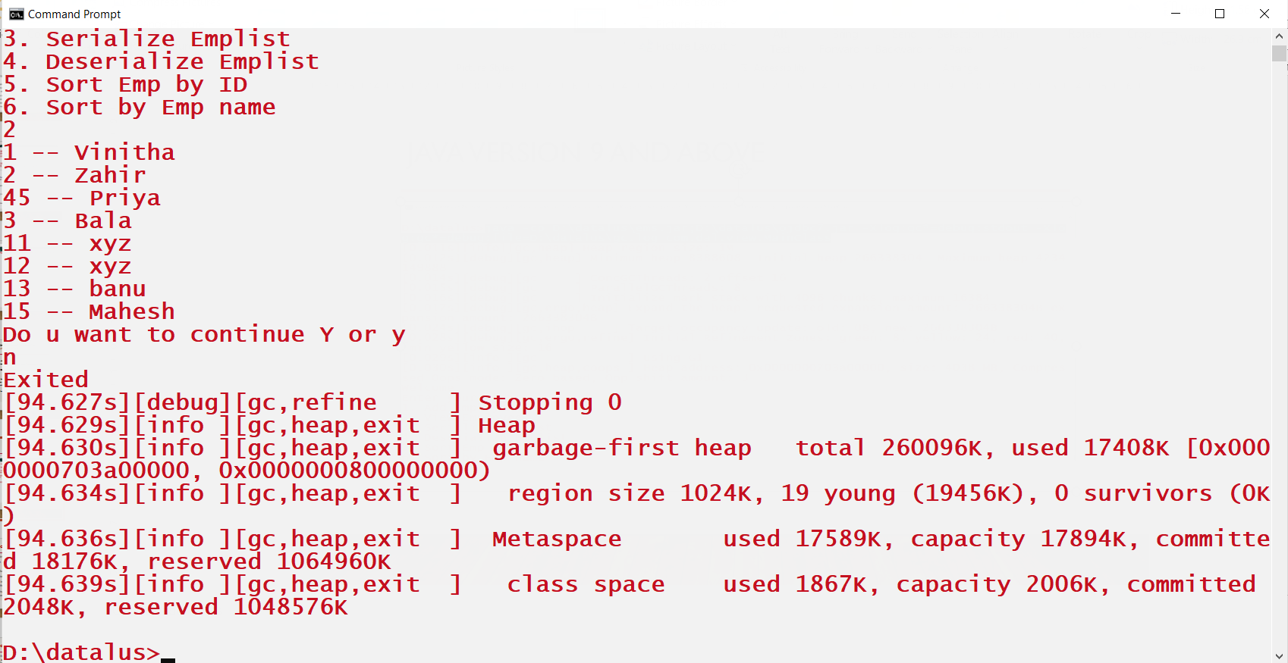
Java version 9 and above

Slide 70
Tune performance programmatically
Programmatic concatenating of strings using StringBuilder or StringBuffer
Use of primitives than Wrapper classes so that JVM stores the value in the stack instead of the heap
Avoid BigInteger and BigDecimal. Use simple “long” or “double”.
Avoiding “+” to concatenate strings in in one statement as Strings are immutable
Use ArrayList instead of LinkedList as ArrayList internal node traversal from the start to the end of the collection is significantly faster than LinkedList traversal
Using custom conversion methods for converting between data typesTo reduce the number of temporary objects, always use custom conversion methods, especially strings and streams.
Notes:
https://www.alibabacloud.com/help/en/sae/latest/jvm-options

Slide 71
Tune performance programmatically
7. Don’t optimize before you know it’s necessary which is the most important performance tuning tips. You should follow common best practices and try to implement your use cases efficiently. But that doesn’t mean that you should replace any standard libraries or build complex optimizations before you proved that it’s necessary.
8. Always be conscious of the cost of parsing and formatting date objects. Unless you need the string right then, it’s much better to represent it as a UNIX timestamp.
9. Use Apache Commons StringUtils.replace instead of string.replace
10. Iteration over recursion. You might be wasting a lot of stack frames for something that might have been implemented using only a few local variables. So, always prefer iteration over recursion.
11. Using EnumSet or EnumMap instead of HashSet and HashMap
Notes:
https://www.alibabacloud.com/help/en/sae/latest/jvm-options

Slide 72
Tune performance programmatically
12. Avoid repeated calls when collection size is known - Iterator.hasNext() and Enumerator.hasMoreElements() do not need to be repeatedly called when the size of the collection is known. Use collection.size() and a loop counter instead.
13. Optimize your hashCode() and equals() methods. A good hashCode() method is essential because it will prevent further calls to the much more expensive equals() as it will produce more distinct hash buckets per set of instances.
14. Use the “finally” block well -- The “finally” block is a key tool for preventing resource leaks. When closing a file or otherwise recovering resources, place the code in a “finally” block to ensure that the resource is always recovered. It allows the programmer to avoid having cleanup code accidentally bypassed by a “return”, “continue”, or “break”. Putting cleanup code in a “finally” block is always a good practice, even when no exceptions are anticipated.
Notes:
https://www.alibabacloud.com/help/en/sae/latest/jvm-options

Slide 73
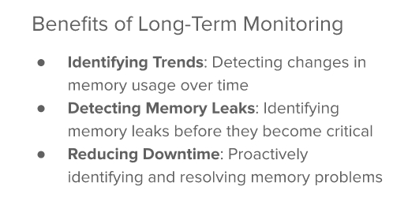
Passive monitoring

Slide 74
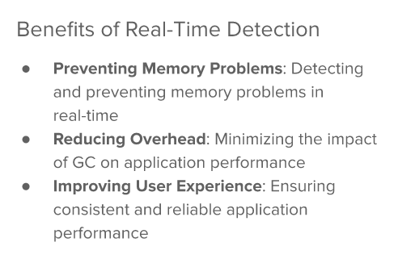
Active monitoring

Slide 75

Tools for monitoring

Slide 76

Post-mortem analysis

Slide 77

Tools for postmortem analysis

Slide 78

Memory problems

Slide 79

Strategies of memory problem

Slide 80

Performance tuning

Slide 81
VisualVM
VisualVM is a free, open-source profiling tool that is bundled with the Java Development Kit (JDK). It provides a user-friendly interface for monitoring and profiling Java applications. Some of its features include:
CPU and memory profiling: VisualVM can monitor the CPU and memory usage of Java applications in real-time.
Thread analysis: VisualVM can analyze the behavior of individual threads within a Java application.
Heap dump analysis: VisualVM can analyze heap dumps to help identify memory leaks and optimize memory usage.
JMX support: VisualVM can connect to Java applications that use Java Management Extensions (JMX) to monitor and manage their resources.
Notes:
JMX stands for Java Management Extensions, which is a technology used for managing and monitoring Java applications. It provides a standard way to expose and manage the resources of a Java application, such as memory usage, CPU usage, and thread usage, as well as allowing for remote management and monitoring of Java applications.
JMX is an important technology for managing and monitoring large-scale Java applications, as it allows for real-time visibility into the performance and health of the application. It is often used in conjunction with tools like JConsole and VisualVM, which provide graphical interfaces for monitoring and managing Java applications.
JMX is part of the Java Platform, Standard Edition (Java SE) and is included in the Java Development Kit (JDK). It is also supported by a wide range of third-party tools and frameworks, making it a popular choice for managing and monitoring Java applications.

Slide 82
JProfiler
JProfiler is a commercial profiling tool that provides advanced features for profiling Java applications. Some of its features include:
CPU and memory profiling: JProfiler can monitor the CPU and memory usage of Java applications in real-time.
Thread analysis: JProfiler can analyze the behavior of individual threads within a Java application.
Memory leak detection: JProfiler can detect memory leaks and provide detailed information on the objects that are causing the leaks.
Database profiling: JProfiler can monitor the SQL statements that are executed by a Java application and provide detailed statistics on their performance.
Live profiling: JProfiler can attach to a running Java application and perform profiling without the need to restart the application.

Slide 83
Load Testing
Load testing is the process of simulating high traffic and usage scenarios for a web or WebService application to evaluate its performance under stress. This type of testing is used to determine how well the application can handle a large number of users, transactions, or requests. Load testing is essential for ensuring that an application can meet the performance expectations of its users and stakeholders.
To perform load testing, there are various tools available that can simulate multiple users and generate heavy traffic on an application. Some popular tools for load testing include JMeter, Gatling, and LoadRunner. These tools allow you to create test scenarios that simulate real-world usage and analyze the performance metrics of the application under various loads.

Slide 84
Advanced Result Assertions
Load testing tools can provide advanced result assertions to validate the correctness of responses, particularly those with dynamic content. Some popular types of result assertions include:
Response Time Assertion: This assertion is used to check the response time of the application for a specific transaction. It can help identify the bottleneck in the application and make improvements accordingly.
Content Assertion: This assertion is used to check the presence and correctness of specific content in the response. For example, if the response contains a specific string or HTML tag, it can be asserted to ensure that the application is returning the correct output.
Regex Assertion: This assertion is used to validate the response based on a regular expression. It can help in cases where the response is dynamic, and the content changes based on user inputs.

Slide 85
Handling Dynamic Content
Dynamic content can be challenging to handle during load testing as it can change from one request to another. Some techniques for handling dynamic content during load testing include:
Correlation: This technique involves capturing a dynamic value from the response and reusing it in subsequent requests. For example, if a session ID is generated dynamically by the application, it can be captured and used in subsequent requests to maintain the session.
Parameterization: This technique involves replacing static values in requests with dynamic values that can be generated during the test. For example, if a user ID needs to be passed in a request, it can be parameterized to generate unique values for each user.
Regular Expressions: Regular expressions can be used to extract dynamic values from the response and use them in subsequent requests. This technique is particularly useful when the dynamic content is not predictable, and correlation or parameterization are not feasible.

Slide 86
Summary of Load Testing and assertions
Load testing is a crucial aspect of web and WebService application testing
Advanced result assertions and handling dynamic content are essential techniques to ensure accurate testing results. By using the right tools and techniques, load testing can help identify performance bottlenecks and ensure that an application can meet the performance expectations of its users.

Slide 87
Jmeter
Building blocks of Jmeter
TestPlan
Thread Group
Samplers
Listeners

Slide 88
Building Blocks of Jmeter
A test plan is a container for all of the elements of a performance test, including the thread groups, samplers, listeners, and other components. A test plan can contain one or more thread groups, which represent a group of threads (simulated users) that execute a specific set of actions against the system being tested.
A thread group is a component in JMeter that defines a group of virtual users (threads) and the parameters that govern their behavior during the test. Within a thread group, you can specify the number of users, the ramp-up time (how quickly the users should be added), the duration of the test, and other parameters. Each thread in the group represents a virtual user that executes a set of actions, or a scenario, against the system being tested.

Slide 89
Building Blocks of Jmeter
Samplers: In JMeter, a sampler is a component that sends a request to a server and waits for a response. Samplers are used to simulate user actions or system interactions, such as sending an HTTP request to an API endpoint, querying a database, or sending an email. Each sampler represents a single request that is sent to the server during the test. JMeter provides a variety of samplers for different protocols, such as HTTP, FTP, JDBC, and more.
Listeners: A listener is a component in JMeter that receives and displays the results of the requests sent by samplers. Listeners are used to monitor the performance and behavior of the system being tested. They provide real-time feedback on metrics such as response time, throughput, error rate, and more. JMeter provides a variety of listeners for different types of data, such as graph results, table results, and aggregate reports.

Slide 90
To create a load testing program in JMeter
Create a Test Plan Open JMeter and create a new Test Plan by selecting File > New. Give it a name and save it.
Add a Thread Group Right-click on the Test Plan and select Add > Threads (Users) > Thread Group. In the Thread Group, set the number of users, ramp-up time, and loop count.
Add HTTP Request Right-click on the Thread Group and select Add > Sampler > HTTP Request. In the HTTP Request, specify the server name or IP address, port number, and path.
Add Listeners Right-click on the Thread Group and select Add > Listener. Listeners help in viewing the test results. You can add any or all of the following listeners: Aggregate Report, Summary Report, View Results in Table, and View Results Tree.
Configure the Test Plan by setting properties like HTTP Request defaults, User Defined Variables, CSV Data Set Config, and others as per your requirement.
Run the Test Plan Save the Test Plan and click the Run button to start the load test. Observe the results in the listeners added in the Test Plan.
Analyze the Results After the load test, analyze the results to understand the performance of the server under the specified load conditions. Use the graphs and reports generated by the listeners to get a better understanding of the test results

Slide 91
To test the load of an API using JMeter
To test the load of an API using JMeter, you can follow these general steps:
Create a test plan: Open JMeter and create a new test plan by selecting "File" -> "New". Give your test plan a name and save it.
Add a Thread Group: In the test plan, add a new Thread Group by right-clicking on the test plan and selecting "Add" -> "Threads (Users)" -> "Thread Group". Set the number of threads (users) and the duration of the test in the Thread Group properties.
Add an HTTP Request: Within the Thread Group, add an HTTP Request sampler by right-clicking on the Thread Group and selecting "Add" -> "Sampler" -> "HTTP Request". Enter the URL of the API you want to test and any necessary parameters or headers.
Add listeners: Add one or more listeners to your test plan to view the results of your load test. Listeners can show metrics such as response time, throughput, and error rate.
Configure and run the test: Configure any additional test settings, such as ramp-up time and test data, and run the test by selecting "Run" -> "Start" or clicking on the "Start" button in the toolbar.
Analyze the results: After the test is complete, analyze the results using the listeners you added. Look for metrics such as response time, throughput, and error rate to identify any performance issues or bottlenecks in the API.

Slide 92

Heap dump using jmap

Slide 93

Heap dump using jcmd

Slide 94

Visual VM

Slide 95

Visual VM

Slide 96

Visual VM

Slide 97

Visual VM

Slide 98

jconsole

Slide 99
JCONSOLE
JConsole provides information about the memory usage and garbage collection (GC) performance of a Java application.
Time: This shows the date and time when the memory usage and GC data was collected.
Used: This shows the amount of memory that is currently being used by the Java application. In this case, the application is using 374,254 kbytes of memory.
Committed: This shows the amount of memory that has been allocated to the Java application by the operating system. In this case, the application has been allocated 462,336 kbytes of memory.
Max: This shows the maximum amount of memory that the Java application is allowed to use. In this case, the maximum amount of memory that the application can use is 3,675,648 kbytes.
GC time: This shows the amount of time that was spent on garbage collection by the JVM. It is broken down by GC algorithm. In this case, the application spent 0.221 seconds on the PS MarkSweep algorithm for five collections and 6.888 seconds on the PS Scavenge algorithm for 3,619 collections.
The PS MarkSweep algorithm is used for the Full GC process, which performs a more thorough garbage collection that scans all objects in the Heap. The PS Scavenge algorithm is used for the Minor GC process, which performs a faster garbage collection that only scans the young generation of objects in the Heap.
If you see that the GC time is increasing over time, it may indicate that your application is creating too many objects and not freeing them up properly, leading to a memory leak or inefficient memory usage.

Slide 100

Thread Dump

Slide 101

Thread dump using jstack

Slide 102

Thread dump using jcmd

Slide 103
Thank you

